Slide 1
MATH221
Mathematics for Computer Science
Unit 10
Introduction to Combinatorics and Probability

Slide 2
Learning Objectives
Introduce sample space, event, possibility tree and counting rules
Introduce basic probability
Introduce permutation and combination
Introduce pigeonhole principle and generalized pigeonhole principle

Slide 3
1: Introduction

Slide 4
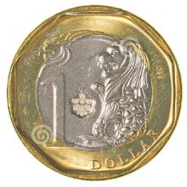
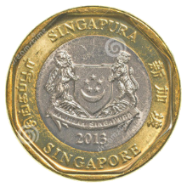
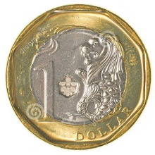

Introduction: Tossing two coins
0, 1 or 2 heads?
Does each of these events occur about 1/3 of the time?
1/4
2/4
1/4
One head obtained
No heads obtained
Two heads obtained

Slide 5
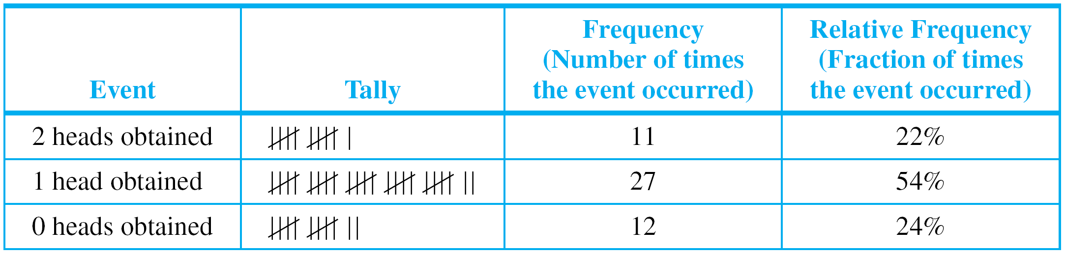
: Introduction: Experiment on Tossing Two Coins
Table 10.1.1. Relative frequencies.
Formalizing the analysis, we introduce:
random process
sample space
event
probability

Slide 6
Introduction
To say that a process is random means that when it takes place, one outcome from some set of outcomes is sure to occur, but it is impossible to predict with certainty which outcome that will be.
Definition
A sample space is the set of all possible outcomes of a random process or experiment.
An event is a subset of a sample space.

Slide 7
Equally Likely Probability
Notation
For a finite set A, N(A) denotes the number of elements in A.
Equally Likely Probability Formula
If S is a finite sample space in which all outcomes are equally likely and E is an event in S, then the probability of E, denoted P(E), is
P(E) =
The number of outcomes in E
N(E)
=
The total number of outcomes in S
N(S)

Slide 8

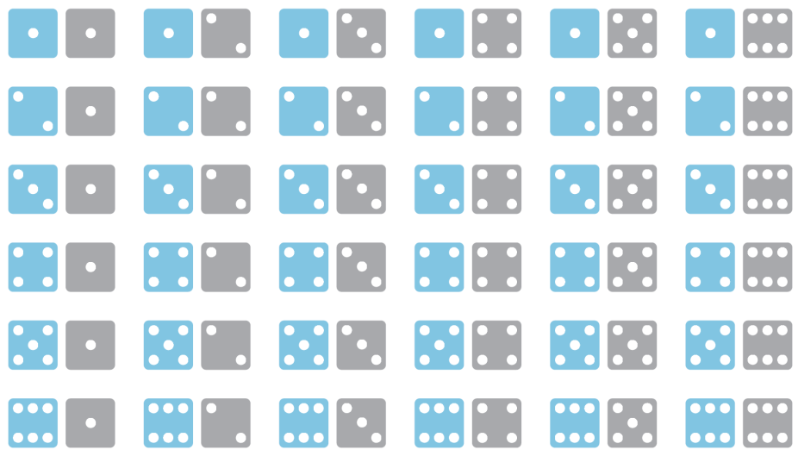
Equally Likely Probability: Rolling a Pair of Dice

Slide 9

Equally Likely Probability: Rolling a Pair of Dice
A more compact notation identifies, say, with the notation 24, with 53, and so forth.
Use the compact notation to write the sample space S of possible outcomes.
Use set notation to write the event E that the numbers showing face up have a sum of 6 and find the probability of this event.
S = { 11, 12, 13, 14, 15, 16, 21, 22, 23, 24, 25, 26, 31, 32, 33, 34, 35, 36,
41, 42, 43, 44, 45, 46, 51, 52, 53, 54, 55, 56, 61, 62, 63, 64, 65, 66 }
E = { 15, 24, 33, 42, 51 }
P(E) = 5/36

Slide 10
Counting the Elements of a List
Some counting problems are as simple as counting the elements of a list.
For instance, how many integers are there from 5 through 12?
list: 5 6 7 8 9 10 11 12
count: 1 2 3 4 5 6 7 8

Slide 11
Counting the Elements of a List
More generally, if m and n are integers and m ≤ n, how many integers are there from m through n ?
Note that n = m + (n – m), where n – m ≥ 0 [since n ≥ m].
Theorem 10.1.1 The Number of Elements in a List
If m and n are integers and m ≤ n, then there are
n – m + 1
integers from m to n inclusive.

Slide 12
Counting the Elements of a List
How many 3-digit integers (from 100 to 999 inclusive) are divisible by 5?
100 101 102 103 104 105 106 107 108 109 110 … 994 995 996 997 998 999
5×20
5×21
5×22
5×199
Number of multiples of 5 from 100 to 999 = number of integers from 20 to 199 inclusive.
From Theorem 10.1.1, there are 199 – 20 + 1 = 180 such integers.
Hence, there are 180 3-digit integers that are divisible by 5.

Slide 13
Counting the Elements of a List and Probability
What is the probability that a randomly chosen 3-digit integer is divisible by 5?
By Theorem 10.1.1, total number of integers from 100 through 999 = 999 – 100 + 1 = 900.
By part (a), 180 of these are divisible by 5.
Hence, answer = 180/900 = 1/5.

Slide 14
2: Possibility Trees and the Multiplication Rule

Slide 15
Possibility Trees
A tree structure is a useful tool for keeping systematic track of all possibilities in situations in which events happen in order.
Coin 1
H
T
Coin 2
H
T
H
T
Coin 3
H
T
H
T
H
T
H
T
Example 1: Possibilities for Tournament Play
Teams A and B are to play each other repeatedly until one wins two games in a row, or a total of three games.
One way in which this tournament can be played is for A to win the first game, B to win the second, and A to win the third and fourth games. Denote this by writing A–B–A–A.

Slide 16
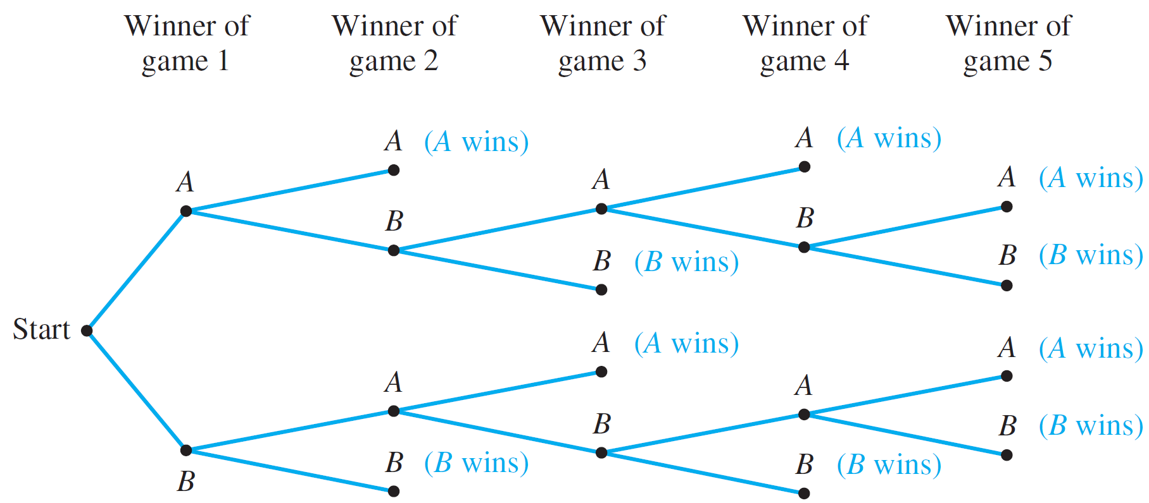
Introduction Possibility Trees and Multiplication Rule Counting Elements of Disjoint Sets The Pigeonhole Principle
Possibility Trees
Example 1: Possibilities for Tournament Play
How many ways can the tournament be played?
Possible ways are represented by the distinct paths from “root” (the start) to “leaf” (a terminal point) in the tree below.
Figure 10.2.1 The Outcomes of a Tournament

Slide 17
Example 1: Possibilities for Tournament Play
How many ways can the tournament be played?
Ten paths from the root of the tree to its leaves ➔ ten possible ways for the tournament to be played.
A-A
A-B-A-A
A-B-A-B-A
A-B-A-B-B
A-B-B
B-A-A
B-A-B-A-A
B-A-B-A-B
B-A-B-B
B-B

Slide 18
Example 1: Possibilities for Tournament Play
Assuming that all the ways of playing the tournament are equally likely, what is the probability that five games are needed to determine the tournament winner?
A-A
A-B-A-A
A-B-A-B-A
A-B-A-B-B
A-B-B
B-A-A
B-A-B-A-A
B-A-B-A-B
B-A-B-B
B-B
Probability that 5 games are needed = 4/10 = 2/5

Slide 19
The Multiplication Rule
Consider the following example.
Suppose a computer installation has four input/output units (A, B, C, and D) and three central processing units (X, Y, and Z).
Any input/output unit can be paired with any central processing unit. How many ways are there to pair an input/output unit with a central processing unit?

Slide 20
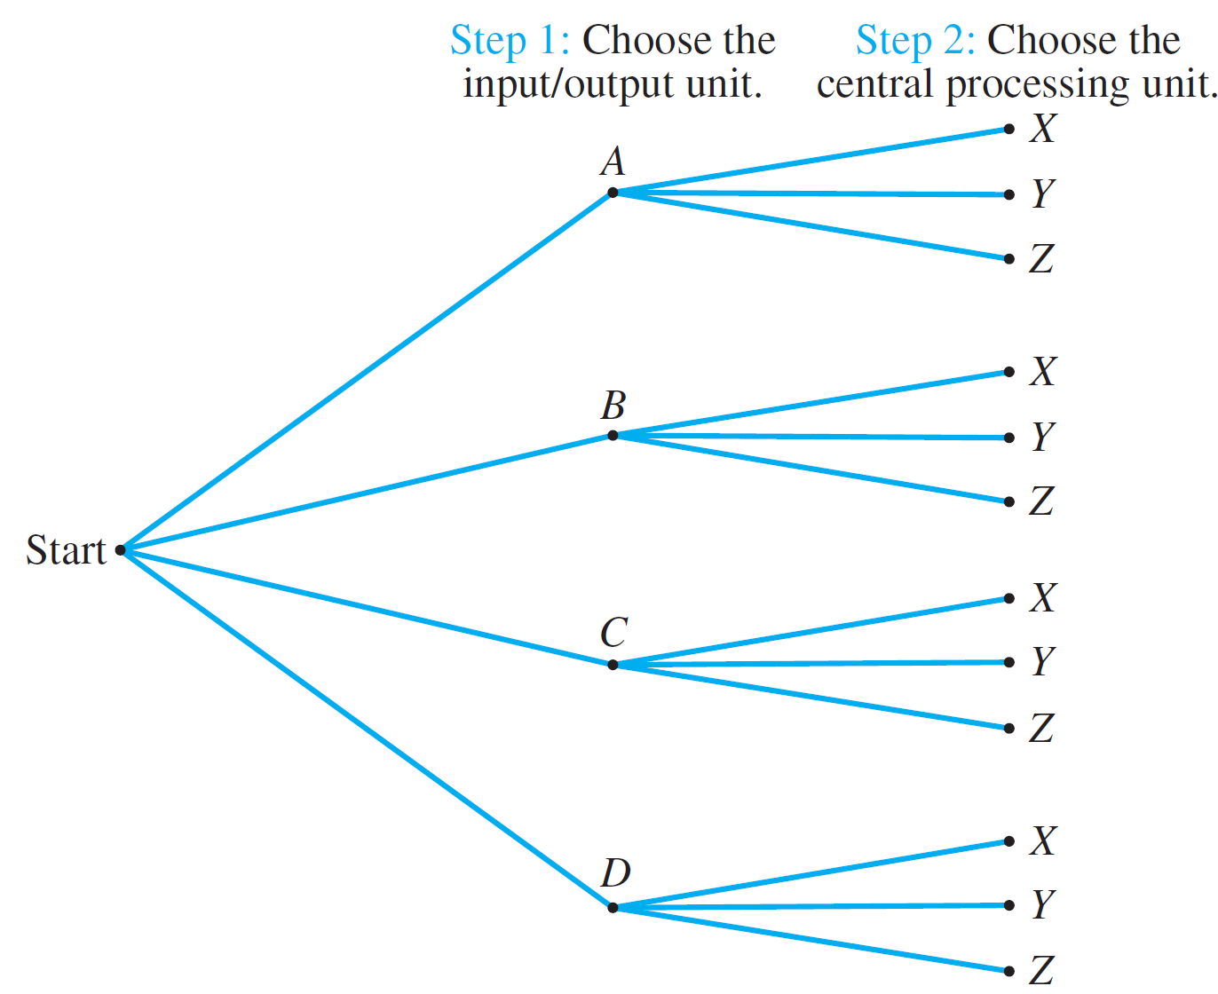
The Multiplication Rule
Possibility tree:
The total number of ways to pair the two types of units…
is the same as the number of branches of the tree:
3 + 3 + 3 + 3 = 4×3 = 12
Figure 10.2.2 Pairing Objects Using a Possibility Tree

Slide 21
The Multiplication Rule
Theorem 10.2.1 The Multiplication Rule
If an operation consists of k steps and
the first step can be performed in n₁ ways,
the second step can be performed in n₂ ways (regardless of how the first step was performed),
:
the k^{th} step can be performed in n_{k} ways (regardless of how the preceding steps were performed),
Then the entire operation can be performed in
n₁ × n₂ × n₃ × … × n_{k} ways.

Slide 22
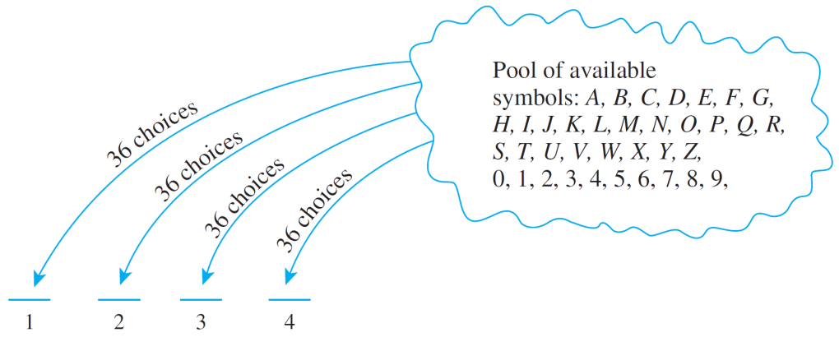
The Multiplication Rule
Example 2: No. of Personal Identification Numbers (PINs)
A typical PIN is a sequence of any four symbols chosen from the 26 letters in the alphabet and the ten digits, with repetition allowed. Examples: CARE, 3387, B32B, and so forth.
How many different PINs are possible?
You can think of forming a PIN as a four-step
operation to fill in each
of the four symbols in
sequence.

Slide 23
Example 2: No. of Personal Identification Numbers (PINs)
Step 1: Choose the first symbol.
Step 2: Choose the second symbol.
Step 3: Choose the third symbol.
Step 4: Choose the fourth symbol.
There is a fixed number of ways to perform each step, namely 36, regardless how preceding steps were performed.
Hence, by the multiplication rule, there are:
36×36×36×36 = 36⁴ = 1,679,616 PINs in all.

Slide 24
Example 3: No. of PINs without Repetition
Now, suppose that repetition is not allowed.
How many different PINs are there?
Step 1: Choose the first symbol.
Step 2: Choose the second symbol.
Step 3: Choose the third symbol.
Step 4: Choose the fourth symbol.
←36 ways
←35 ways
←34 ways
←33 ways
Hence, by the multiplication rule, there are:
36×35×34×33 = 1,413,720 PINs in all with no repeated symbol.

Slide 25
Example 3: No. of PINs without Repetition
If all PINs are equally likely, what is the probability that a PIN chosen at random contains no repeated symbols?
1,679,616 PINS in all.
1,413,720 PINs with no repeated symbol.
Hence, probability that a PIN chosen at random contains no repeated symbols:
1,413,720
≅ 0.8417
1,679,616

Slide 26
When the Multiplication Rule is Difficult/Impossible to Apply
Example 4: Consider the following problem:
Three officers – a president, a treasurer, and a secretary – are to be chosen from among four people: Ann, Bob, Cyd, and Dan. Suppose that, for various reasons, Ann cannot be president and either Cyd or Dan must be secretary. How many ways can the officers be chosen?
Is this correct?
It is natural to try to solve this problem using the multiplication rule. A person might answer as follows:
There are three choices for president (all except Ann), three choices for treasurer (all except the one chosen as president), and two choices for secretary (Cyd or Dan).
Therefore, by the multiplication rule, 3×3×2 = 18

Slide 27
When the Multiplication Rule is Difficult/Impossible to Apply
It is incorrect. The number of ways to choose the secretary varies depending on who is chosen for president and treasurer.
For instance, if Bob is chosen for president and Ann for treasurer, then there are two choices for secretary: Cyd and Dan.
But if Bob is chosen for president and Cyd for treasurer, then there is just one choice for secretary: Dan.

Slide 28
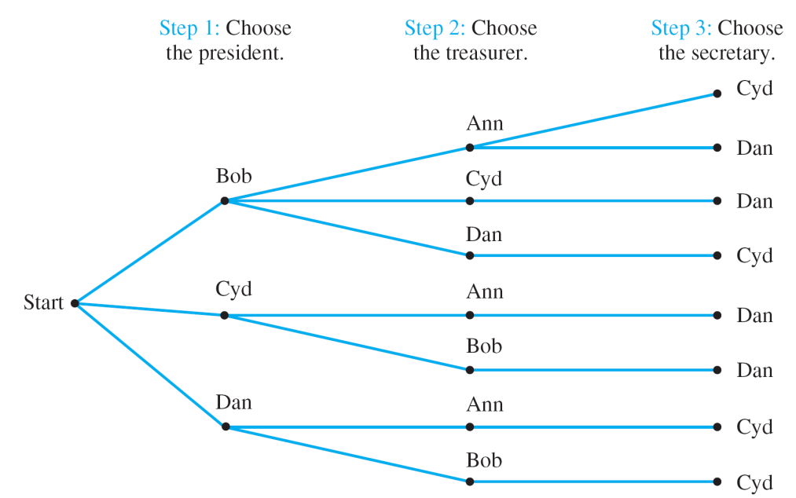
When the Multiplication Rule is Difficult/Impossible to Apply
The clearest way to see all the possible choices is to construct the possibility tree, as shown below.
How many ways?
8 ways.
Figure 10.2.3

Slide 29
When the Multiplication Rule is Difficult/Impossible to Apply
Example 5: A More Subtle Use of the Multiplication Rule
Reorder the steps for choosing the officers in the previous example so that the total number of ways to choose officers can be computed using the multiplication rule.
2 ways: Either Cyd or Dan.
Step 1: Choose the secretary.
Step 2: Choose the president.
Step 3: Choose the treasurer.
2 ways: Neither Ann nor the person chosen in step 1 may be chosen, but either of the other two may.
2 ways: Either of the 2 persons not chosen in steps 1 and 2 may be chosen.
Hence, total number of ways = 2 ×2 ×2 = 8

Slide 30
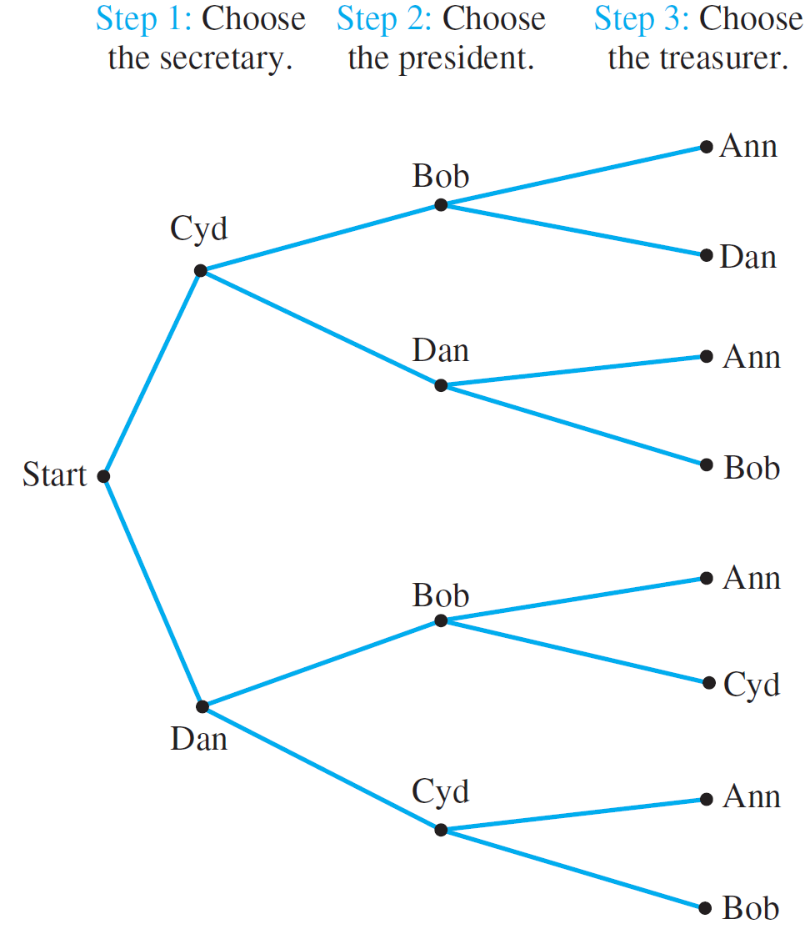
Example 5: A More Subtle Use of the Multiplication Rule
A possibility tree illustrating this sequence of choices:
Figure 10.2.4

Slide 31
Permutations
A permutation of a set of objects is an ordering of the objects in a row. For example, the set of elements a, b, and c has six permutations.
abc acb cba bac bca cab
In general, given a set of n objects, how many permutations does the set have?

Slide 32
Permutations
Imagine forming a permutation as an n-step operation:
Step 1: Choose an element to write first.
Step 2: Choose an element to write second.
Step 3: Choose an element to write third.
:
Step n: Choose an element to write nth.
← n ways
← n – 1 ways
← n – 2 ways
← 1 way
By the multiplication rule, there are
n × (n – 1) × (n – 2) × … × 2 × 1 = n!
ways to perform the entire operation.

Slide 33
Permutations
In other words, there are n! permutations of a set of n elements.
Theorem 10.2.2 Permutations
The number of permutations of a set with n (n ≥ 1) elements is n!

Slide 34
Permutations
Example 6 – Permutations of the Letters in a Word
How many ways can the letters in the word COMPUTER be arranged in a row?
All the eight letters in the word COMPUTER are distinct. Hence, 8! = 40320.
How many ways can the letters in the word COMPUTER be arranged if the letters CO must remain next to each other (in order) as a unit?
There are effectively only seven objects “CO”, “M”, “P”, “U”, “T”, “E” and “R”. Hence, 7! = 5040.

Slide 35
Permutations
Example 6 – Permutations of the Letters in a Word
If letters of the word COMPUTER are randomly arranged in a row, what is the probability that the letters CO remain next to each other (in order) as a unit?
The probability is:
7!
8!
1
8
=

Slide 36
Permutations
Permutations of Selected Elements
Given the set {a, b, c}, there are six ways to select two letters from the set and write them in order.
ab ac ba bc ca cb
Each such ordering of two elements of {a, b, c} is called a 2-permutation of {a, b, c}?.
Definition
An r-permutation of a set of n elements is an ordered selection of r elements taken from the set.
The number of r-permutations of a set of n elements is denoted P(n, r).

Slide 37
Permutations of Selected Elements
Theorem 10.2.3 r-permutations from a set of n elements
If n and r are integers and 1 ≤ r ≤ n, then the number of r-permutations of a set of n elements is given by the formula
P(n, r) = n(n – 1)(n – 2) … (n – r + 1) first version
or, equivalently,
P(n, r) = second version
n!
(n – r)!

Slide 38
Permutations of Selected Elements
Example 7
Evaluate P(5, 2).
P(5, 2) = 5! / (5 – 2)! = 5 × 4 = 20
How many 4-permutations are there of a set of seven objects?
P(7, 4) = 7! / (7 – 4)! = 7 × 6 × 5 × 4 = 840
How many 5-permutations are there of a set of five objects?
P(5, 5) = 5! / (5 – 5)! = 5! = 120

Slide 39
3: Addition and Difference Rules

Slide 40
Counting Elements of Disjoint Sets: The Addition Rule
The basic rule underlying the calculation of the number of elements in a union or difference or intersection is the addition rule.
This rule states that the number of elements in a union of mutually disjoint finite sets equals the sum of the number of elements in each of the component sets.
Theorem 10.3.1 The Addition Rule
Suppose a finite set A equals the union of k distinct mutually disjoint subsets A₁, A₂, …, A_{k}. Then
N(A) = N(A₁) + N(A₂) + … + N(A_{k}).

Slide 41
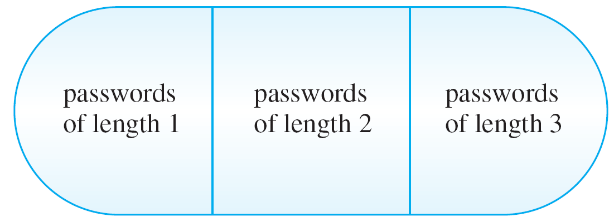
Counting Elements of Disjoint Sets: The Addition Rule
Example 8 – Counting Passwords with 3 or fewer Letters
A computer access password consists of from one to three letters chosen from the 26 letters in the alphabet with repetitions allowed. How many different passwords are possible?
The set of all passwords can be partitioned into subsets consisting of those of length 1, length 2, and length 3:
Figure 10.3.1
Set of all passwords of length ≤ 3

Slide 42
Counting Elements of Disjoint Sets: The Addition Rule
Example 8 – Counting Passwords with 3 or fewer Letters
By the addition rule, the total number of passwords equals the sum of the number of passwords of length 1, length 2, and length 3.
Number of passwords of length 1 = 26
Number of passwords of length 2 = 26²
Number of passwords of length 3 = 26³
Hence, total number of passwords = 26 + 26² + 26³
= 18,278.

Slide 43
The Difference Rule
An important consequence of the addition rule is the fact that if the number of elements in a set A and the number in a subset B of A are both known, then the number of elements that are in A and not in B can be computed.
Theorem 10.3.2 The Difference Rule
If A is a finite set and B is a subset of A, then
N(A – B) = N(A) – N(B).

Slide 44
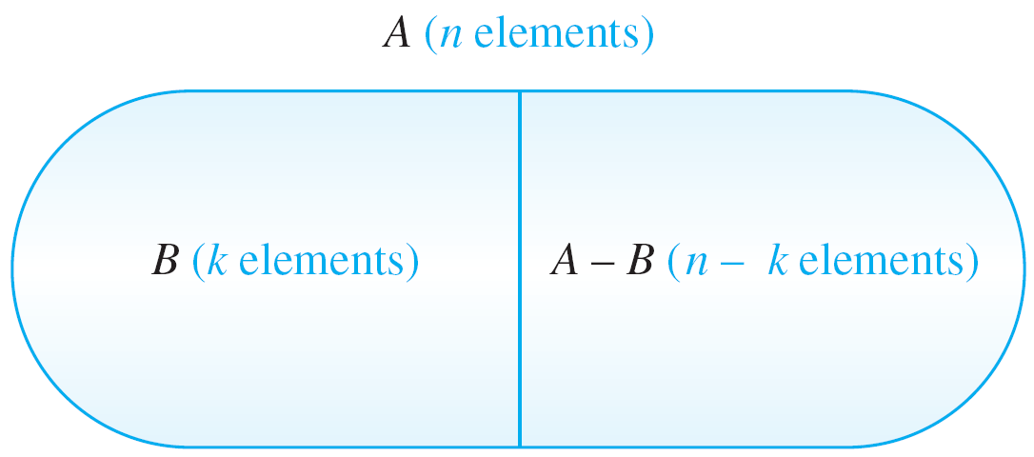
Counting Elements of Disjoint Sets: The Addition Rule
The difference rule is illustrated in Figure 10.3.2.
Figure 10.3.2 The Difference Rule

Slide 45
The Difference Rule
The difference rule holds for the following reason: If B is a subset of A, then the two sets B and A – B have no elements in common and B ∪ (A – B) = A. Hence, by the addition rule,
N(B) + N(A – B) = N(A).
Subtracting N(B) from both sides gives the equation
N(A – B) = N(A) – N(B)

Slide 46
The Difference Rule
Example 9 – Counting PINs with Repeated Symbols
A typical PIN (personal identification number) is a sequence of any four symbols chosen from the 26 letters in the alphabet and the ten digits, with repetition allowed.
How many PINs contain repeated symbols?
There are 36⁴ = 1,679,616 PINs when repetition is allowed, and there are 36 × 35 × 34 × 33 = 1,413,720 PINs when repetition is not allowed.
By the difference rule, there are
1,679,616 – 1,413,720 = 265,896
PINS that contain at least one repeated symbol.

Slide 47
The Difference Rule
Example 9 – Counting PINs with Repeated Symbols
If all PINs are equally likely, what is the probability that a randomly chosen PIN contains a repeated symbol?
There are 1,679,616 PINs in all, and by part (a) 265,896 of these contain at least one repeated symbol.
Thus, the probability that a randomly chosen PIN contains a repeated symbol is
265,896
1,679,616
≅ 0.158

Slide 48
The Difference Rule
Example 9 – Counting PINs with Repeated Symbols
An alternative solution to part (b) is based on the observation that if S is the set of all PINs and A is the set of all PINs with no repeated symbol, then S – A is the set of all PINs with at least one repeated symbol.
It follows that:
N(S – A)
N(S)
N(S) – N(A)
N(S)
1,413,720
1,679,616
P(S – A) =
=
P(A) =
N(S)
N(S)
N(A)
N(S)
≅ 0.842
=
–
P(S – A) ≅ 1 – 0.842
≅ 0.158
= 1 – P(A)

Slide 49
The Difference Rule
Probability of the Complement of an Event
This solution illustrates a more general property of probabilities: that the probability of the complement of an event is obtained by subtracting the probability of the event from the number 1.
Formula for the Probability of the Complement of an Event
If S is a finite sample space and A is an event in S, then
P(A^{c}) = 1 – P(A).

Slide 50
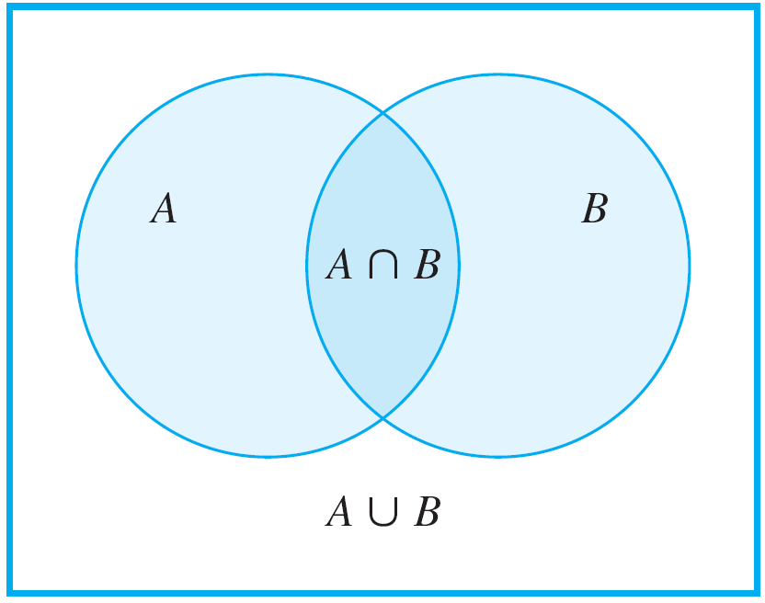
The Inclusion/Exclusion Rule
The Inclusion/Exclusion Rule
The addition rule says how many elements are in a union of sets if the sets are mutually disjoint. Now consider the question of how to determine the number of elements in a union of sets when some of the sets overlap.
For simplicity, begin by looking at a union of two sets A and B, as shown in Figure 10.3.3.
Figure 10.3.3

Slide 51
The Inclusion/Exclusion Rule
To get an accurate count of the elements in A ∪ B, it is necessary to subtract the number of elements that are in both A and B. Because these are the elements in A ∩ B,
N(A ∪ B) = N(A) + N(B) – N(A ∩ B).
Theorem 10.3.3 The Inclusion/Exclusion Rule for 2 or 3 Sets
If A, B, and C are any finite sets, then
N(A ∪ B) = N(A) + N(B) – N(A ∩ B)
and
N(A ∪ B ∪ C) = N(A) + N(B) + N(C) – N(A ∩ B)
– N(A ∩ C) – N(B ∩ C) + N(A ∩ B ∩ C).

Slide 52
The Inclusion/Exclusion Rule
Example 10 – Counting Elements of a General Union
How many integers from 1 through 1,000 are multiples of 3 or multiples of 5?
Let A = the set of all integers in [1..1000] that are multiples of 3.
Let B = the set of all integers in [1..1000] that are multiples of 5.
Then A ∪ B = the set of all integers in [1..1000] that are multiples of 3 or multiples of 5.
Then A ∩ B = the set of all integers in [1..1000] that are multiples of both 3 and 5
= the set of all integers in [1..1000] that are multiples of 15.

Slide 53
The Inclusion/Exclusion Rule
Example 10 – Counting Elements of a General Union
How many integers from 1 through 1,000 are multiples of 3 or multiples of 5?
As every third integer from 3 through 999 is a multiple of 3, each can be represented in the form 3k, for some integer k in [1..333].
Hence there are 333 multiples of 3 from 1 through 1000, and so N(A) = 333
Similarly, every multiple of 5 from 1 through 1000 has the form 5k, for some integer k in [1..200].
Hence there are 200 multiples of 5 from 1 through 1000, and so N(B) = 200

Slide 54
The Inclusion/Exclusion Rule
Example 10 – Counting Elements of a General Union
How many integers from 1 through 1,000 are multiples of 3 or multiples of 5?
Finally, every multiple of 15 from 1 through 1000 has the form 15k, for some integer k in [1..66] (since 990 = 66 × 15).
Hence there are 66 multiples of 15 from 1 through 1000, and so N(A ∩ B) = 66
It follows by the inclusion/exclusion rule that
N(A ∪ B) = N(A) + N(B) – N(A ∩ B)
= 333 + 200 – 66 = 467
Thus, 467 integers from 1 through 1000 are multiples of 3 or multiples of 5.

Slide 55
The Inclusion/Exclusion Rule
Example 10 – Counting Elements of a General Union
How many integers from 1 through 1,000 are neither multiples of 3 nor multiples of 5?
There are 1000 integers from 1 through 1000.
By part (a), 467 of these are multiples of 3 or multiples of 5.
Thus, by the difference rule, there are 1000 – 467 = 533 that are neither multiples of 3 nor multiples of 5.

Slide 56
The Inclusion/Exclusion Rule
Note that the solution to part (b) of Example 10 hid a use of De Morgan’s law.
The number of elements that are neither in A nor in B is N(A^{c} ∩ B^{c}).
By De Morgan’s law, A^{c} ∩ B^{c} = (A ∪ B)^{c}.
So N((A ∪ B)^{c}) was then calculated using the set difference rule: N((A ∪ B)^{c}) = N(U) – N(A ∪ B), where the universe U was the set of all integers from 1 through 1,000.

Slide 57
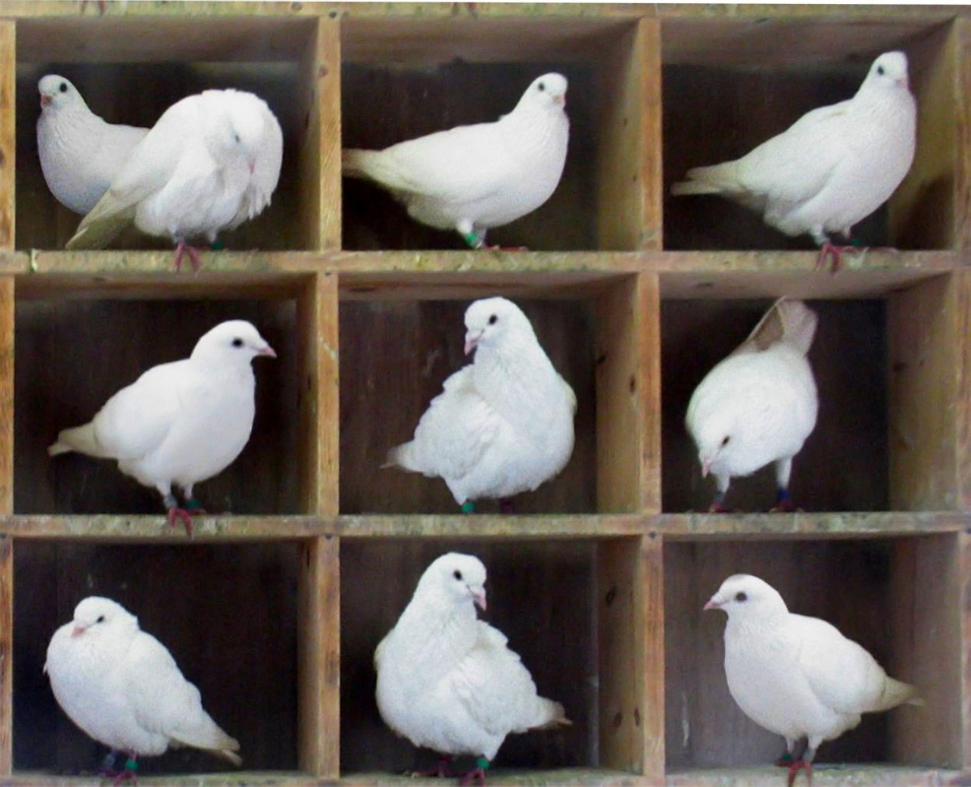
4: The Pigeonhole Principle

Slide 58

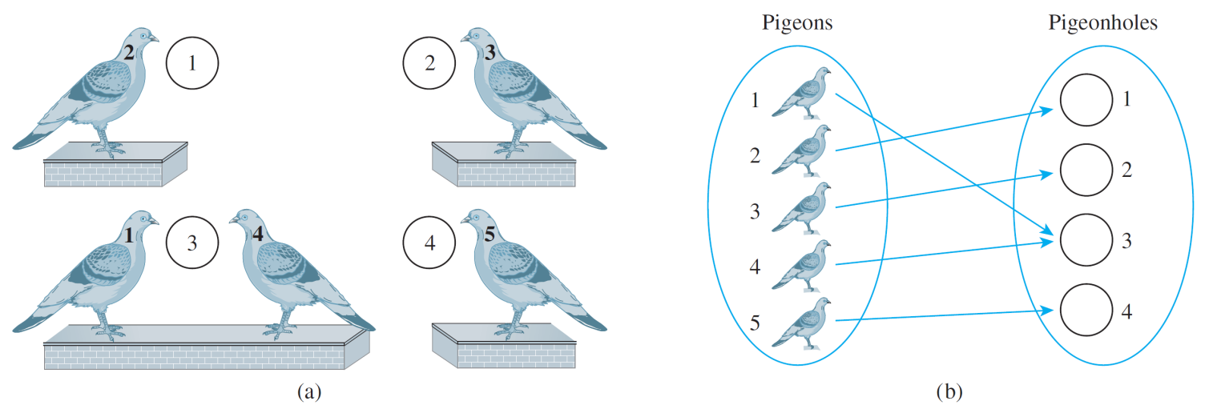
The Pigeonhole Principle: Introduction
If n pigeons fly into m pigeonholes and n > m, then at least one hole must contain two or more pigeons.
Figure 9.4.1 n = 5 and m = 4

Slide 59
The Pigeonhole Principle
The pigeonhole principle is sometimes called the Dirichlet box principle because it was first stated formally by J. P. G. L. Dirichlet (1805–1859).
Mathematical formulation:
Pigeonhole Principle
A function from one finite set to a smaller finite set cannot be one-to-one: There must be at least 2 elements in the domain that have the same image in the co-domain.

Slide 60
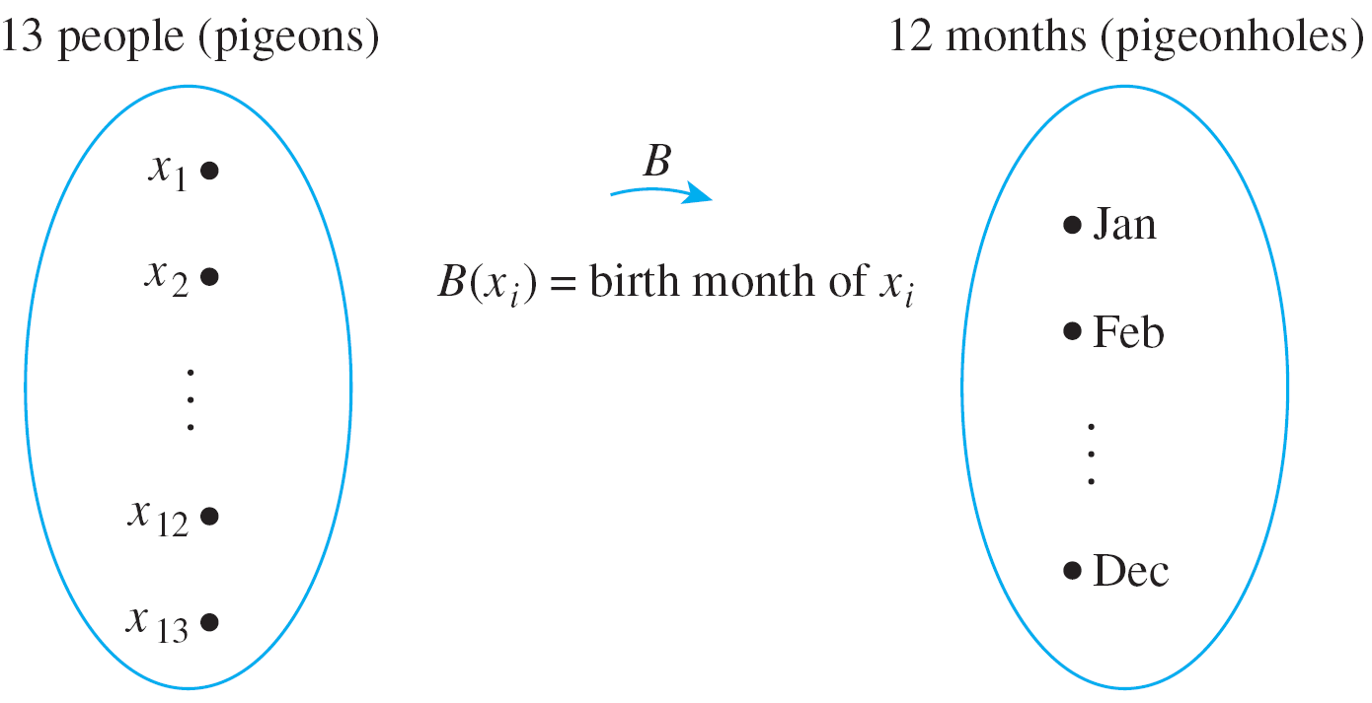
The Pigeonhole Principle
Example 11 – Applying the Pigeonhole Principle
In a group of six people, must there be at least two who were born in the same month?
In a group of 13 people, must there be at least two who were born in the same month? Why?
No.
Yes. At least 2 people must have been born in the same month.

Slide 61
Generalized Pigeonhole Principle
If n pigeons fly into m pigeonholes and, for some positive integer k, k < n/m, then at least one pigeonhole contains k + 1 or more pigeons.
Generalized Pigeonhole Principle
For any function f from a finite set X with n elements to a finite set Y with m elements and for any positive integer k, if k < n/m, then there is some y ∈ Y such that y is the image of at least k + 1 distinct elements of X.

Slide 62
Generalized Pigeonhole Principle
Example 12 – Applying the Generalized Pigeonhole Principle
Show how the generalized pigeonhole principle implies that in a group of 85 people, at least 4 must have the same last initial (‘A’, ‘B’, …, ‘Z’).
In this example the pigeons are the 85 people and the pigeonholes are the 26 possible last initials of their names. Note that
3 < 85/26 ≅ 3.27

Slide 63
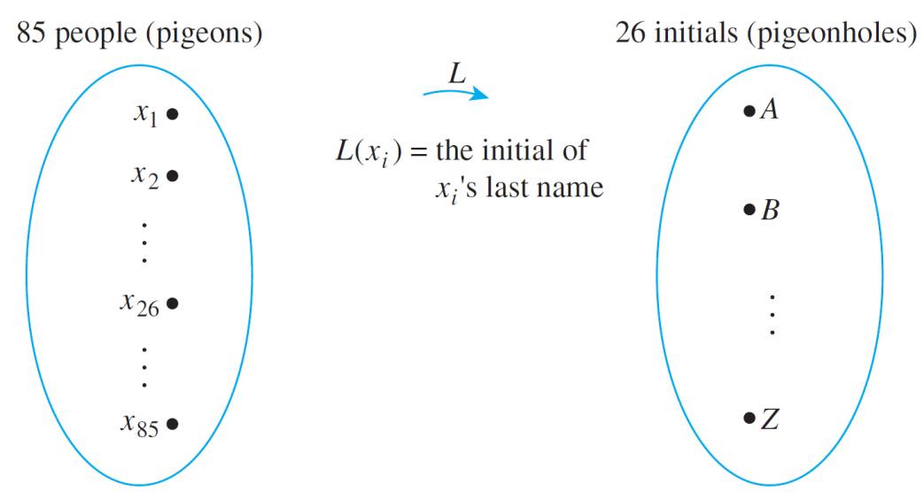
Generalized Pigeonhole Principle
Example 12 – Applying the General Pigeonhole Principle
Consider the function L from people to initials defined by the following arrow diagram.
Since 3 < 85/26, the generalized pigeonhole principle states that some initial must be the image of at least four (3 + 1) people.
Thus, at least 4 people have the same last initial.
■

Slide 64
5: Combinations

Slide 65
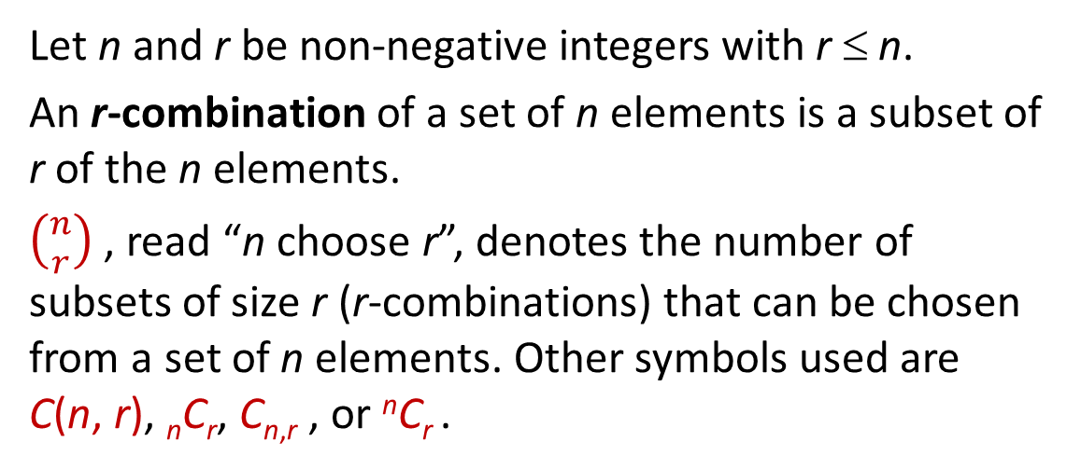
Counting Subsets of a Set: Combinations
Given a set S with n elements, how many subsets of size r can be chosen from S?
Each subset of size r is called an r-combination of the set.
Definition: r-combination
Let n and r be non-negative integers with r ≤ n.
An r-combination of a set of n elements is a subset of r of the n elements.
$\left({n \atop r}\right)$ , read “n choose r”, denotes the number of subsets of size r (r-combinations) that can be chosen from a set of n elements. Other symbols used are C(n, r), _{n}C_{r}, C_{n,r} , or ^{n}C_{r} .

Slide 66
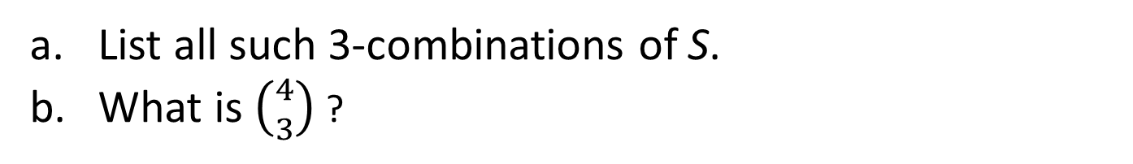
Counting Subsets of a Set: Combinations
Example 13-Combinations
Let S = {Ann, Bob, Cyd, Dan}. Each committee consisting of three of the four people in S is a 3-combination of S.
List all such 3-combinations of S.
What is $\left({4 \atop 3}\right)$ ?
The 3-combinations are:
{Bob, Cyd, Dan}, {Ann, Cyd, Dan},
{Ann, Bob, Dan}, {Ann, Bob, Cyd}
$\left({4 \atop 3}\right)$ = 4

Slide 67
Counting Subsets of a Set: Combinations
Example 14 – Ordered and Unordered Selection
Two distinct methods that can be used to select r objects from a set of n elements:
Ordered selection
Unordered selection
Also called r-permutation
Also called r-combination
Example: S = { 1, 2, 3 }
2-permutations of S
2-combinations of S
{1, 2}
{2, 1}
{1, 2}
{1, 3}
{3, 1}
{1, 3}
{2, 3}
{3, 2}
{2, 3}

Slide 68
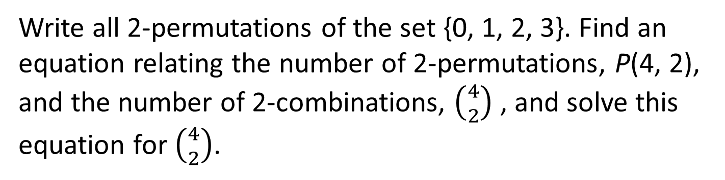
Relationship between Permutations and Combinations
Example 15 – Relationship between Permutations and Combinations
Write all 2-permutations of the set {0, 1, 2, 3}. Find an equation relating the number of 2-permutations, P(4, 2), and the number of 2-combinations, $\left({4 \atop 2}\right)$ , and solve this equation for $\left({4 \atop 2}\right)$.
{0, 1},
{0, 2},
{0, 3},
{1, 2},
{1, 3}.
{2, 3},
{1, 0},
{2, 0},
{3, 0},
{2, 1},
{3, 1}.
{3, 2}
According to Theorem 10.2.3,
P(4, 2) = 4!/(4-2)! = 4!/2! = 12
The construction of a 2-permutation of {0, 1, 2, 3} can be thought of comprising two steps:
Step 1: Choose a subset of 2 elements from {0, 1, 2, 3}.
Step 2: Choose an ordering for the 2-element subset.

Slide 69
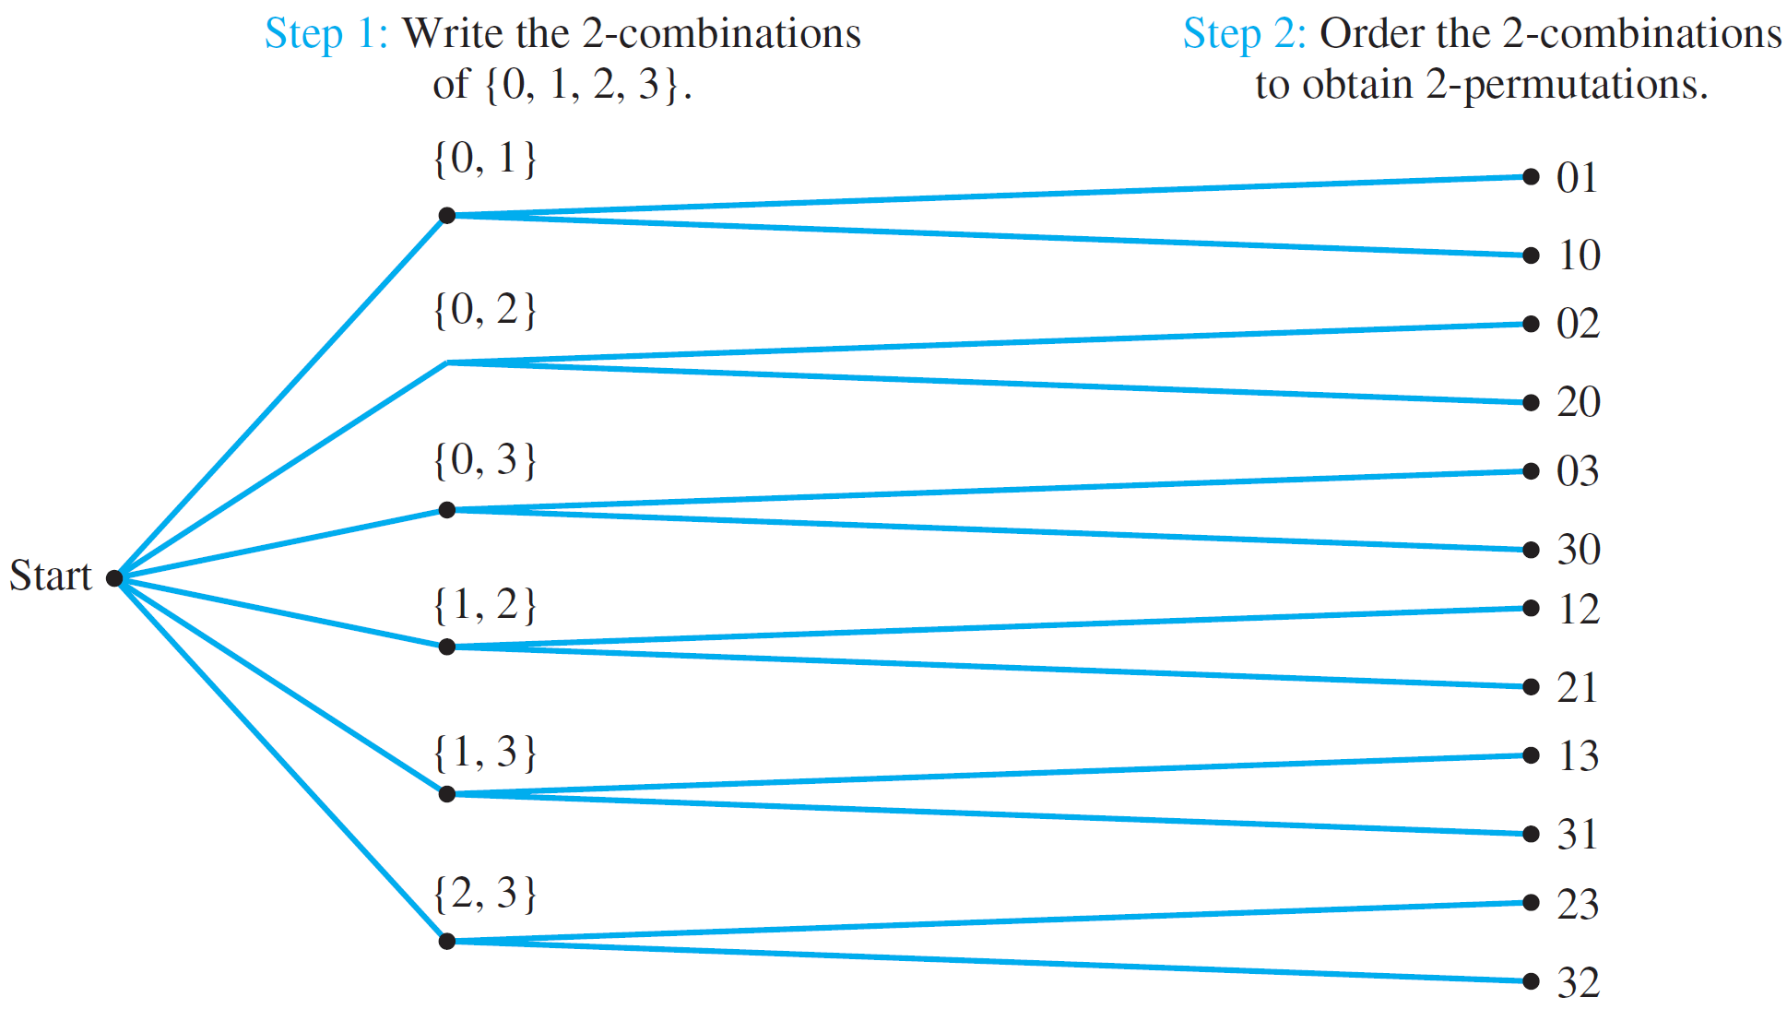
Relationship between Permutations and Combinations
Example 15 – Relationship between Permutations and Combinations
This can be illustrated by the following possibility tree:
Figure 10.5.1 Relationship between Permutations and Combinations

Slide 70
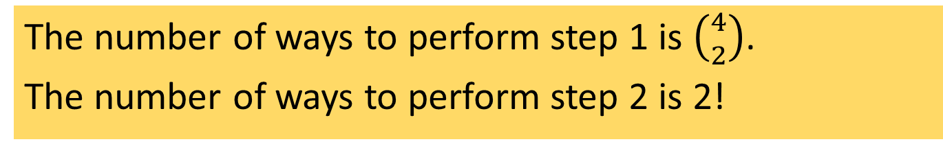
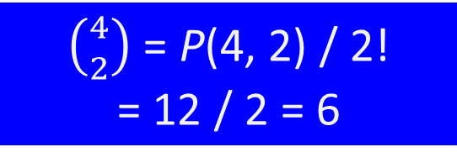

Relationship between Permutations and Combinations
Example 15 – Relationship between Permutations and Combinations
The number of ways to perform step 1 is $\left({4 \atop 2}\right)$.
The number of ways to perform step 2 is 2!
Hence,
P(4, 2) = $\left({4 \atop 2}\right)$⋅ 2!
$\left({4 \atop 2}\right)$ = P(4, 2) / 2!
= 12 / 2 = 6

Slide 71

Relationship between Permutations and Combinations
Theorem 10.5.1 Formula for $\left({n \atop r}\right)$
The number of subsets of size r (or r-combinations) that can be chosen from a set of n elements, $\left({n \atop r}\right)$, is given by the formula
$\left({n \atop r}\right)= \frac{P(n, r)}{r!}$
or, equivalently,
$\left({n \atop r}\right)= \frac{n!}{r!\left(n−r\right)!}$
where n and r are non-negative integers with r ≤ n.

Slide 72

Relationship between Permutations and Combinations
Example 16 – Teams with Members of Two Types
Suppose the group of 12 consists of 5 men and 7 women.
How many 5-person teams can be chosen that consist of 3 men and 2 women?
Hint: Think of it as a two-step process:
Step 1: Choose the men.
Step 2: Choose the women.
$$\left({5 \atop 3}\right)×\left({7 \atop 2}\right)= \frac{5!}{3!2!}×\frac{7!}{2!5!}=210$$

Slide 73


Relationship between Permutations and Combinations
Example 16 – Teams with Members of Two Types
Suppose the group of 12 consists of 5 men and 7 women.
How many 5-person teams contain at least one man?
Hint: May use difference rule or addition rule.
The former is shorter.
Let A be the set of all 5-person teams,
and B be the set of 5-person teams without any men.
$$\left({12 \atop 5}\right)=792$$
$$\left({7 \atop 5}\right)=21$$
Then N(A) = , and N(B) =
Therefore number of 5-person teams that contain at least one man =
792 – 21 = 771

Slide 74
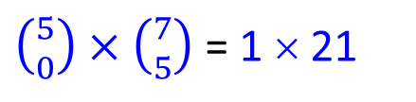
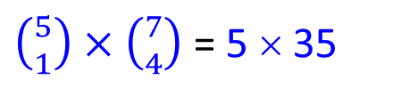
Relationship between Permutations and Combinations
Example 16 – Teams with Members of Two Types
Suppose the group of 12 consists of 5 men and 7 women.
How many 5-person teams contain at most one man?
$\left({5 \atop 0}\right)×\left({7 \atop 5}\right)$ = 1 × 21
Number of teams without any man =
= 21
$\left({5 \atop 1}\right)×\left({7 \atop 4}\right)$ = 5 × 35
Number of teams with one man =
= 175
Therefore number of 5-person teams that contain at most one man =
21 + 175 = 196

Slide 75
6: The Binomial Theorem

Slide 76

Pascal’s Formula
Pascal’s formula can be derived by two entirely different arguments. One is algebraic; it uses the formula for the number of r-combinations obtained in Theorem 10.5.1
Theorem 10.6.1 Pascal’s Formula
Let n and r be positive integers, r ≤ n. Then
$\left({n+1 \atop r}\right)= \left({n \atop r−1}\right)+\left({n \atop r}\right)$

Slide 77
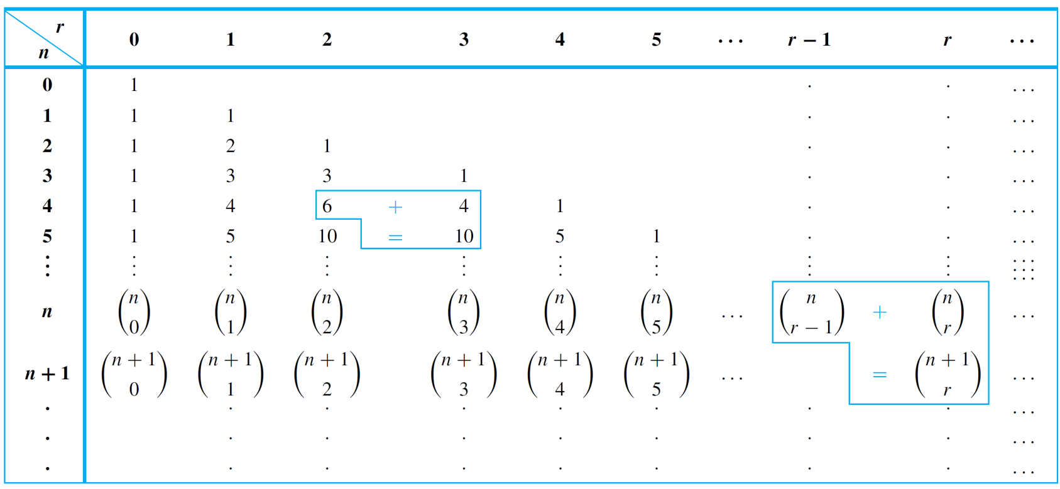
Pascal’s Formula
Pascal’s triangle is a geometric version of Pascal’s formula.
Table 10.6.1 Pascal’s Triangle

Slide 78
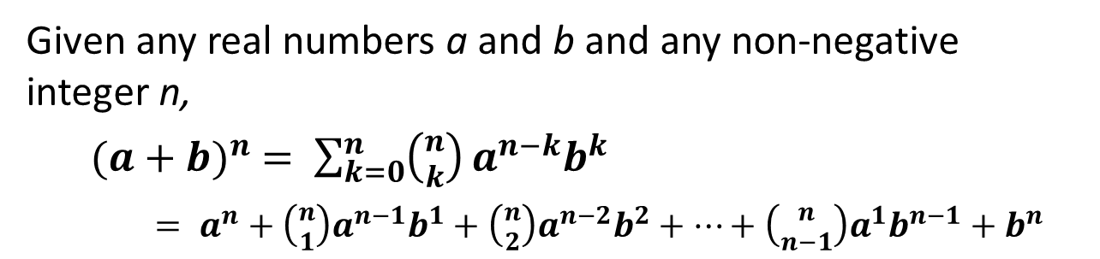
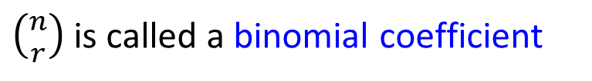
The Binomial Theorem
In algebra a sum of two terms, such as a + b, is called binomial.
The binomial theorem gives an expression for the powers of a binomial (a + b)^{n}, for each positive integer n and all real numbers a and b.
$\left({n \atop r}\right)$is called a binomial coefficient
Theorem 10.6.2 Binomial Theorem
Given any real numbers a and b and any non-negative integer n,
${(a+b)}^{n} = \sum_{k=0}^{n}{\left({n \atop k}\right)}a^{n−k}b^{k}$
$= a^{n}+\left({n \atop 1}\right)a^{n−1}b^{1}+\left({n \atop 2}\right)a^{n−2}b^{2}+⋯+\left({n \atop n−1}\right)a^{1}b^{n−1}+b^{n}$

Slide 79
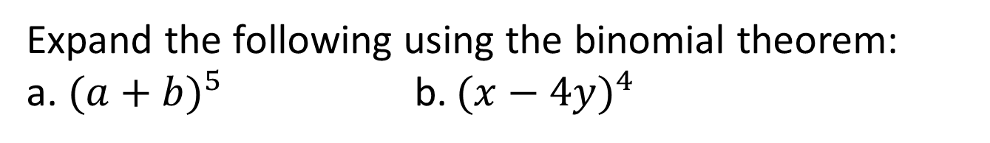
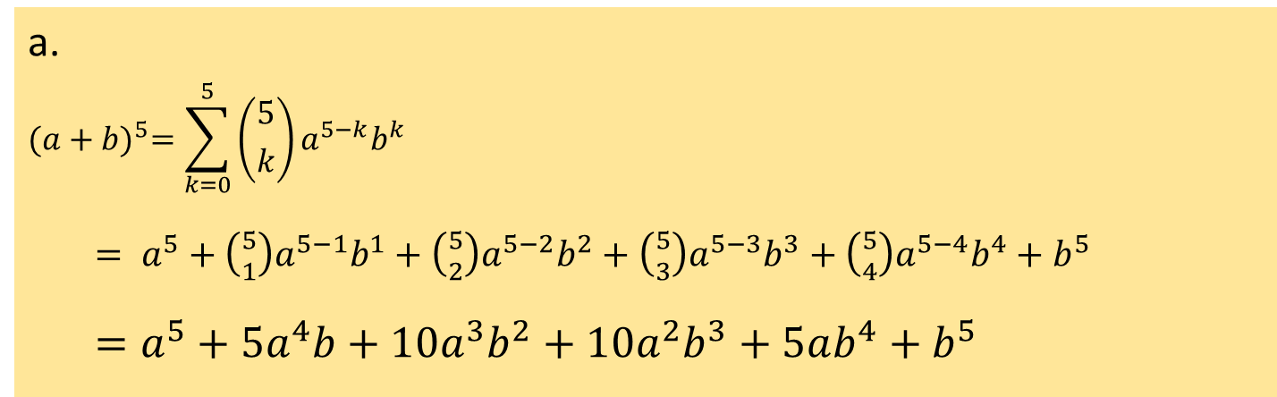
The Binomial Theorem
Example 17 – Substituting into the Binomial Theorem
Expand the following using the binomial theorem:
a. ${(a+b)}^{5}$ b. ${(x−4y)}^{4}$
a.
$${(a+b)}^{5}=\sum_{k=0}^{5}{\left({5 \atop k}\right)}a^{5−k}b^{k}$$
$= a^{5}+\left({5 \atop 1}\right)a^{5−1}b^{1}+\left({5 \atop 2}\right)a^{5−2}b^{2}+\left({5 \atop 3}\right)a^{5−3}b^{3}+\left({5 \atop 4}\right)a^{5−4}b^{4}+b^{5}$
$=a^{5}+5a^{4}b+10a^{3}b^{2}+10a^{2}b^{3}+5ab^{4}+b^{5}$

Slide 80
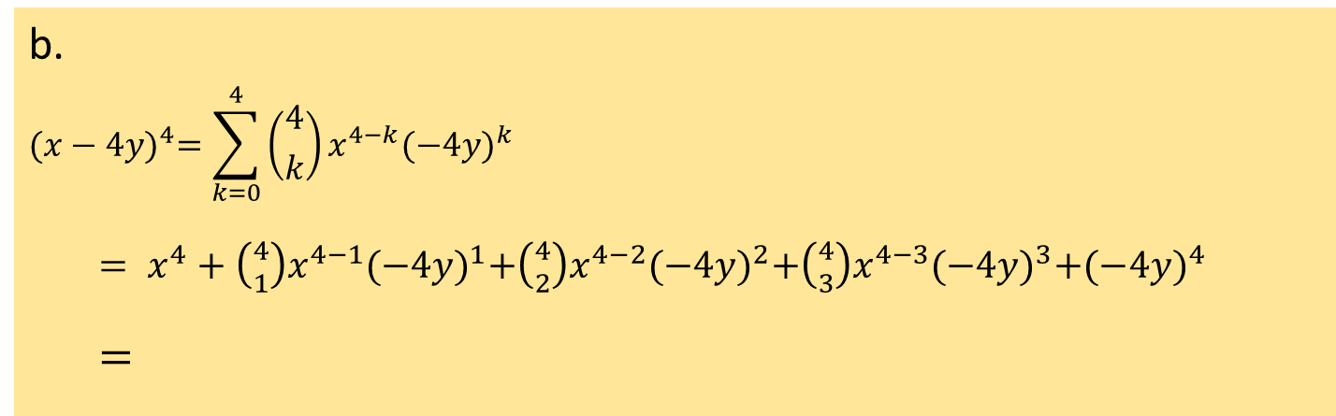
The Binomial Theorem
Example 17 – Substituting into the Binomial Theorem
Expand the following using the binomial theorem:
a. ${(a+b)}^{5}$ b. ${(x−4y)}^{4}$
b.
$${(x−4y)}^{4}=\sum_{k=0}^{4}{\left({4 \atop k}\right)}x^{4−k}{(−4y)}^{k}$$
$= x^{4}+\left({4 \atop 1}\right)x^{4−1}{(−4y)}^{1}+\left({4 \atop 2}\right)x^{4−2}{(−4y)}^{2}+\left({4 \atop 3}\right)x^{4−3}{(−4y)}^{3}+{(−4y)}^{4}$
$=$
$$x^{4}−16x^{3}y+96x^{2}y^{2}−256xy^{3}+256y^{4}$$

Slide 81
End of Unit 10

